Slide 1
The Swedish system of administrative data
Ulf Durnell
October 2016

Slide 2
The Challenges in the transformative agenda
Riding the big data wave
Increasing cost & difficulty of collecting data
New competitors & changing expectations
Competition for skilled resources
Rapid changes in the environment
Reducing
budget
Notes:
ABS, like other National Statistical Institutions, faces shared constraints and challenges.
External Challenges
rapidly changing external environment
More sophisticated users
Demand for timeliness and responsiveness
increasing demand for more accessible and ‘joined up’ data to solve complex policy questions
Constraints
Reduced funding and volatility in funding
Our costs are increasing significantly – unable to contact many households, response rates dropping, difficult to recruit and retain interviewers
skills shortages – competing for statistical and ICT skills across government
complex work programs
siloed processes
and aging infrastructure
2

Slide 3
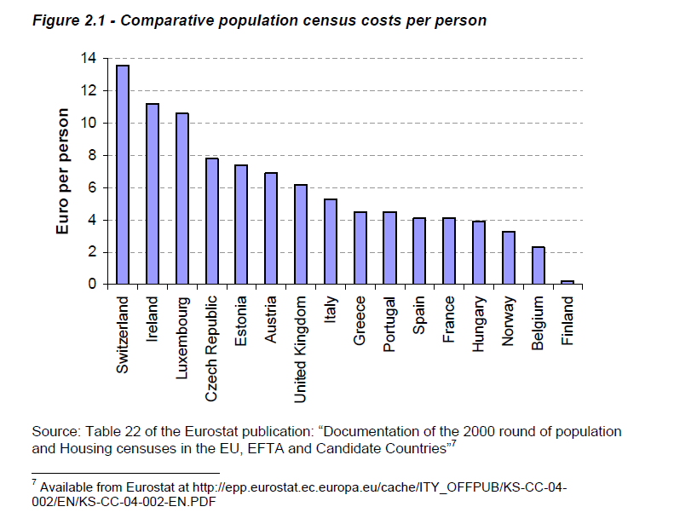
The Cost Factor – census 2000

Slide 4
Eurostats vision 2020 – re-engineering
Modernization of statistical production of official statistics:
New alternative data sources
ESS VIP ADMIN,
ESS NET Big Data
Consider:
Quality
IT infrastructure
Skills
Experience sharing
Legislation

Slide 5
Statistics Sweden’s register system
Labour market | Household finances | Living Conditions
Population | Income and taxation | Employment - individuals
Democracy | Integration | Education
Bankruptcy
Statement of earnings
Value added tax (VAT)
Tax declaration
Schools
Standardized accounting statements as an appendix to tax return
Employment – Enterprise/Local unit
Foreign trade
Total
Population register
PIN
Real estate prices
Real estate tax assessments
Motor vehicles
Geography
Dwellings
New construction
Conversions
Demolition
Business register
BIN
Real estate register
Address

Slide 6
The role as a national coordinator
National Population Registration
The Swedish Tax Agency

Slide 7
Cooperation with the providers an example
Residents in multi-dwelling buildings
Dwelling number
Local authority
Address
Address
(Dwel id)
Dwel id
Updating
National Land Survey
Dwelling register
Dwel id
Dwel id
Tax Agency
Pop.registration
Real estate owners
Dwel id
Key
Initial collection of
data
Dwel id, Key
PIN
Dwel id, Key
Dwellings in the Real Estate Register
Key
Persons in Total Population Register
SCB

